Slide 1
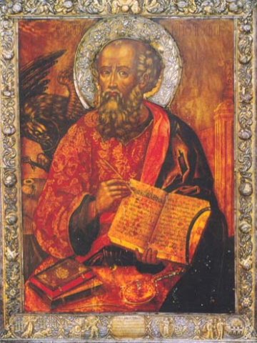
A Letter of Encouragement to a Peculiar People-4
1 John

Slide 2
REVIEW
I write these things to you who believe in the name of the Son of God so that you may know (be certain, assured, confident) that you have eternal life. 5:13
The bridge called Faith: Started across…Hesitating…Scared…Uncertain
Is Jesus able? Does he want to? Am I worthy?
Counsel: Remember/Focus
Whose they are (Doctrine)—Who Jesus is…He is able/eager
Creator (meaning), Life (alive), Fellowship with God (God is love)
God is Light
How that reality should direct their living (Ethics)
Walk in the light

Slide 3
Walking in the Light—What does it mean?
Personal
Walk in the light of conscience
Walk in the light of common sense
Walk in the light of love
Cultural
Walk in the light of consensus or public opinion—social contract
Walk in the light of what peers say or believe
Problem: Human!

Slide 4
Walking in the Light—What does it mean?
Your word is a lamp to my feet and a light for my path. Psalm 119:105
For what we believe—Doctrine/What is true?
For how we live—Ethics /What is good and moral?
Peculiar People

Slide 5
Reality exposed by the light—Fundamental problem: Sin
If we claim to be without sin, we deceive ourselves and the truth is not in us. If we confess our sins, he is faithful and just and will forgive us our sins and purify us from all unrighteousness.
If we claim we have not sinned, we make him out to be a liar and his word has no place in our lives.
My dear children, I write this to you so that you do not sin. But if anyone does sin, we have one who speaks to the Father in our defense—Jesus Christ , the Righteous One. He is the atoning sacrifice for our sin, and not for our sin only, but also for the sins of the whole world.
1 John 1:8-2:2

Slide 6
sIn
Exists
We have
Forgiven

Slide 7
Holy Spirit, Light divine
Dawn upon this soul of mine
Let your Word dispel the night
Wake my spirit, clear my sight…

Slide 8
REVIEW
I write these things to you who believe in the name of the Son of God so that you may know (be certain, assured, confident) that you have eternal life. 5:13
Know 26x (16x we know)
Faith: Hesitating…Uncertain
Is Jesus able? Does he want to? Am I worthy?
Counsel: Remember
Whose they are (Doctrine)
How that reality should direct their living (Ethics)—Walk in the light
Your word is a lamp to my feet and a light for my path. Psalm 119:105
Peculiar People determine truth and goodness by that light

Slide 9
A Letter of Encouragement to a Peculiar People-
Week 5
1 John 2:3-11

Slide 10
REVIEW
I write these things to you who believe in the name of the Son of God so that you may know (be certain, assured, confident) that you have eternal life. 5:13
Know 26x (16x we know)
Confusion
Is Jesus able?
Does he want to?
Am I worthy?
Advice: Remember
Whose they are
How they should live

Slide 11
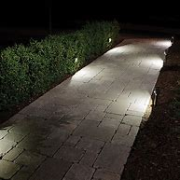
Walking in the light
(Jesus…Word)
→
Think/Act correctly
The foundation: 1:5-2:2
The light reveals our situation:
Created by God
Created to love God
Turned our back on God
Invited to return to God
Then: 2:3-11
The light reveals how we should live
Sin
Forgiveness
Confess
Avoid

Slide 12
We know that we have come to know him if we obey his commands. The man who says, "I know him," but does not do what he commands is a liar, and the truth is not in him. But if anyone obeys his word, God's love is truly made complete in him. This is how we know we are in him: Whoever claims to live in him must walk as Jesus did. Dear friends, I am not writing you a new command but an old one, which you have had since the beginning. This old command is the message you have heard. Yet I am writing you a new command; its truth is seen in him and you, because the darkness is passing and the true light is already shining. Anyone who claims to be in the light but hates his brother is still in the darkness. Whoever loves his brother lives in the light, and there is nothing in him to make him stumble. But whoever hates his brother is in the darkness and walks around in the darkness; he does not know where he is going, because the darkness has blinded him. 2:3-11

Slide 13
The light shows that we should:
1. Walk as Jesus did (:6)
Constant contact with God
Constantly serving others
Example
Jesus’

Slide 14
The light shows that we should:
2. Follow commandments (:3, 4)
Old: Behavior Old Testament
New: Light is shining
Sin/Forgiveness →
Motivation
Power
Specific: Loves his brother
35…36…27…103 (84 chapters)
Commandments
Example
Jesus’
Notes:
Are specific: Loves his brother (Love: 35x)
36x Matthew, Mark, Luke…27x John…Paul 103 (84 chapters—17x 1 John

Slide 15
The Assurance
We unquestionably have eternal life if we:
1. Acknowledge our situation (Failure and forgiveness)
2. Follow the example of Jesus (Walk as Jesus did)
3. Obey the commandments
(Love one another)
Commandments
Example of Jesus
Confess our sin
Notes:
Are specific: Loves his brother (Love: 35x)
36x Matthew, Mark, Luke…27x John…Paul 103 (84 chapters—17x 1 John

