Slide 1
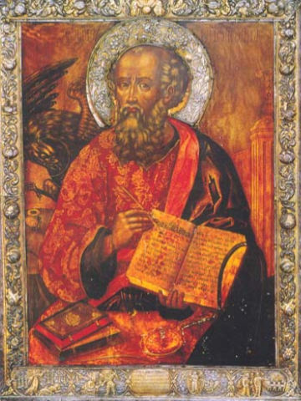
A Letter of Encouragement to a Peculiar People-
Week 6
1 John 2:12-14

Slide 2

REVIEW
I write these things to you who believe in the name of the Son of God so that you may know (be certain, assured, confident) that you have eternal life. 5:13
Confusion
Is Jesus able?
Will I receive it?
Advice: Remember
a. Whose they are
b. How they should live in light of whose they are
A Peculiar People

Slide 3

The Assurance
You know you have eternal life if you: Walk in the light
1. Acknowledge your situation (Failure and forgiveness)
2. Follow the example of Jesus (Walk as Jesus did)
3. Obey the commandments
(Love one another)
Commandments
Example of Jesus
Confess our sin

Slide 4
1 John 2:12-14
I write to you, dear children, because your sins have been forgiven on account of his name.
I write to you, fathers, because you have known him who is from the beginning.
I write to you, young men, because you have overcome the evil one.
I write to you, dear children, because you have known the Father.
I write to you, fathers, because you have known him who is from the beginning.
I write to you, young men, because you are strong, and the word of God lives in you, and you have overcome the evil one.

Slide 5
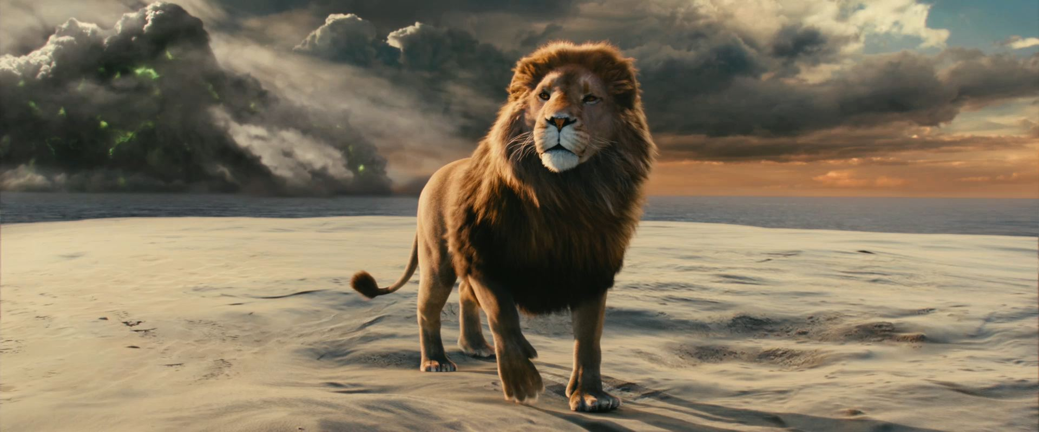
“Every year you grow, you will find me bigger.”

Slide 6
Why this advice at this point?
Whoever loves his brother lives in the light… 2:10
Problem: To love is hard!!
We fail…families fail…churches fail
One source of discouragement/doubt
=
Failure to love (conflict in the church)
One source of conflict: Generational Differences
2:12-14-Identify differences → deal with in healthy way
What each contributes, needs, issues to address

Slide 7
A second source of age-based conflict: Spiritual Immaturity
Question: is John talking about chronological or spiritual groups?
The plan: Spiritual growth
When I was a child, I talked like a child, I thought like a child, I reasoned like a child. When I became a man, I put childish ways behind me. 1 Corinthians 13:11
Too often the reality:
Brothers, I could not address you as spiritual but as worldly-- mere infants in Christ. I gave you milk, not solid food, for you were not yet ready for it. Indeed, you are still not ready. I Corinthians 3:1-2
Some chronologically “mature” are spiritually “children”
And
Some chronologically “children” and spiritually “mature

Slide 8
Signs of spiritual childishness:
Petty conflicts: You are infants when you are jealous and quarrelsome.
1 Corinthians 3:1-3
Lack discernment: You are infants when you are blown here and there by every wind of teaching... Ephesians 4:14
Unstudied: You are infants when you need someone to teach you the elementary truths of God's word all over again…not acquainted with the teaching about righteousness… Hebrews 5:12-13

Slide 9

Ministry to every member…
Every member in ministry
Each has particular experience
Each Contribute
Each Receive:
Church offer/Person accept
Each brings:
Issues need to address:
Let us love one another.

Slide 10
Dear Children
He said: "I tell you the truth, unless you change and become like little children, you will never enter the kingdom of heaven.” Matthew 18:2-3
Child-like (vs childish)
???

Slide 11
Dear children
I write to you, dear children (τέκνον), because your sins have been forgiven on account of his name.
I write to you, dear children (παιδίον), because you have known the Father.
Positive Characteristics: Joined the family and know the Father
Contribute: Model of commitment to the church and trust in the Father
Offered/Accepted: Community which is safe, loving, and nurturing
Issues: Immature…Self-centered

Slide 12
Young adults
I write to you, young men, because you have overcome the evil one.
I write to you, young men, because you are strong, and the word of God lives in you, and you have overcome the evil one.
Positive Characteristics: Faced the enemy and overcome (νενικήκατε)
Contribute: Energy/Strength…Word of God…Creativity/new perspective
Offered/Accepted: Responsibility…Counsel/Teaching/Guidance
Issues: Idealism (Impatience)…Overconfidence

Slide 13
Mature adults
I write to you, fathers, because you have known him who is from the beginning.
I write to you, fathers, because you have known him who is from the beginning.
Positive Characteristics: Experience with Christ and over time
Contribute: Leadership/mentoring by example and with wisdom
Offered/Accepted: Respect…Responsibility
Issues: Resistance to change (We never did it that way before…)
Resistance to sharing responsibility/authority
Withdrawal

Slide 14
The body is a unit, though it is made up of many parts; and though all its parts are many, they form one body. So it is with Christ. 1 Corinthians 12:12
Chronological or Spiritual
Children—Family
Young Adults—Is an Enemy
Mature Adults—Wisdom
Positive Characteristics
Something to Contribute
Something to Receive
Issues
Let us love one another.

